Slide 1
Sprint 3
Level shifts

Slide 2
Agenda
Outliers
Level shifts
strucchange package
tsoutliers package
rank-based shift detection
Timestamps
Data aggregation
gwloggeR v0.1.2

Slide 3
Outliers
Recap

Slide 4


Outliers: v0.02
Validation
Excluded: BAOL089|BAOL079|BAOL006 (mBar)
Range: 800 < x < 1200
Notes:
Excluded: BAOL089|BAOL079|BAOL006
Range: 800 < x < 1200

Slide 5
Outliers: v0.02 example detect_outliers(x, apriori("air pressure", "cmH2O"))

Slide 6
Outliers: v0.02
Next steps
Build kernel based on clean data
Simulation test: verify power
Document in detail
Notes:
Excluded: BAOL089|BAOL079|BAOL006
Range: 800 < x < 1200

Slide 7
Level Shifts
strucchange
tsoutlier
rank-based

Slide 8
strucchange package
For modeling changes in mean

Slide 9
Level shift?

Slide 10
Strucchange package

Slide 11
Strucchange package
Pros:
Detects changes in a linear model (e.g. intercept only linear regression)
Mature package
Speed: 5 min average
Cons:
No ARIMA support
Uses lots of memory (+5GB on some cases)

Slide 12
tsoutliers package
For modeling level shifts with ARIMA models

Slide 13
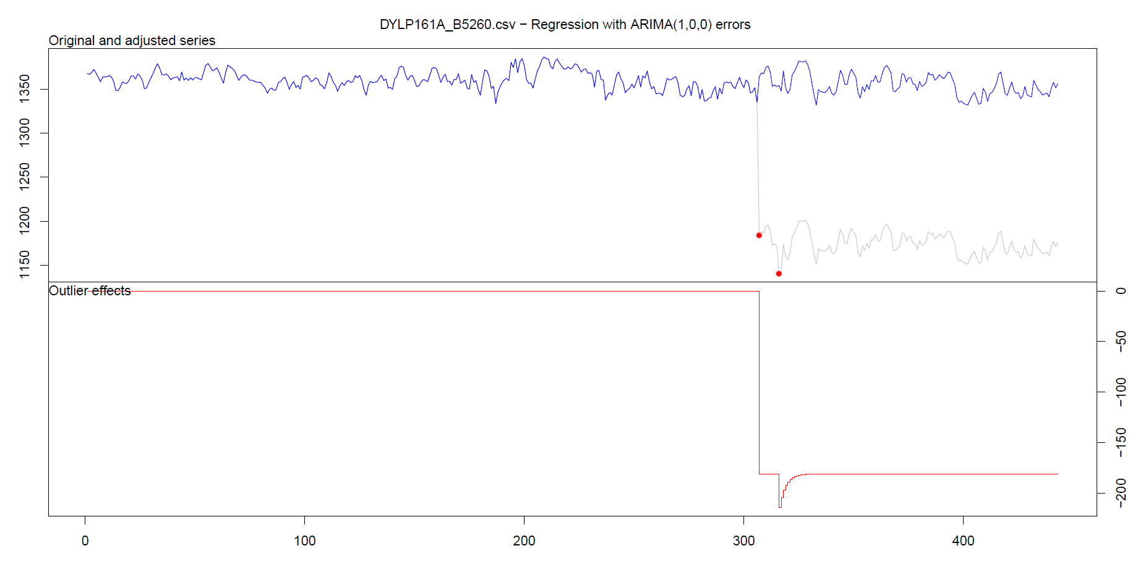
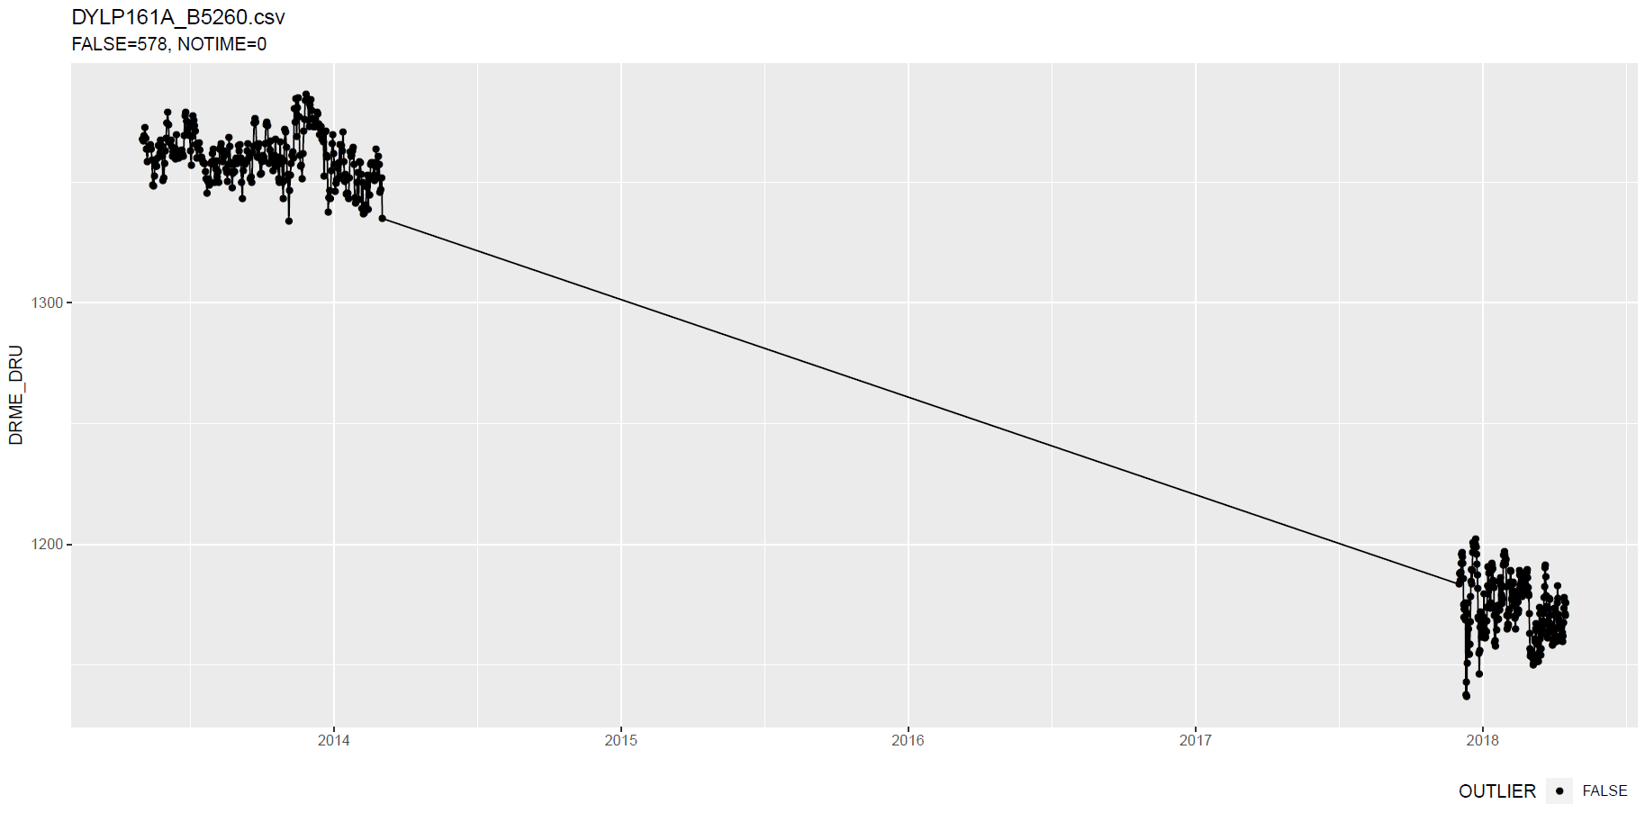
tsoutliers package
Notes:
Wat hier ook kan zijn, is dat intussentijd de situatie gewoon geleidelijk is gewijzigd: dus niet abrupt.

Slide 14
tsoutliers package
More cases: see here.

Slide 15
tsoutliers package
Pros:
Allows for a wide range of ARIMA-based models
Seems to detect LS well
Speed: 10 min average with aggregation
Cons:
Can not be used without aggregation (for >5k points)
Package is still in development

Slide 16
Rank-based shift detection
For modeling level shifts with rank-based statistics

Slide 17
Rank based level shift detection
Fried, R. e.a., On rank tests for shift detection in time series, 2007
Bovik, A.C. e.a., Nonparametric Tests for Edge Detection in Noise, 1986
Based on the distribution of a test statistic (e.g. Wilcoxon statistic) the normal situation can be defined. Based on this definition, exceptional shift situations could be detected.
Pro: speed!

Slide 18
Defining Level Shift
Discussion

Slide 19
Level shift?

Slide 20
Level shift?
Notes:
Lots of missing data!!

Slide 21
Level shift?

Slide 22
Level shift?

Slide 23
Level shift?
Notes:
2 shifts?

Slide 24
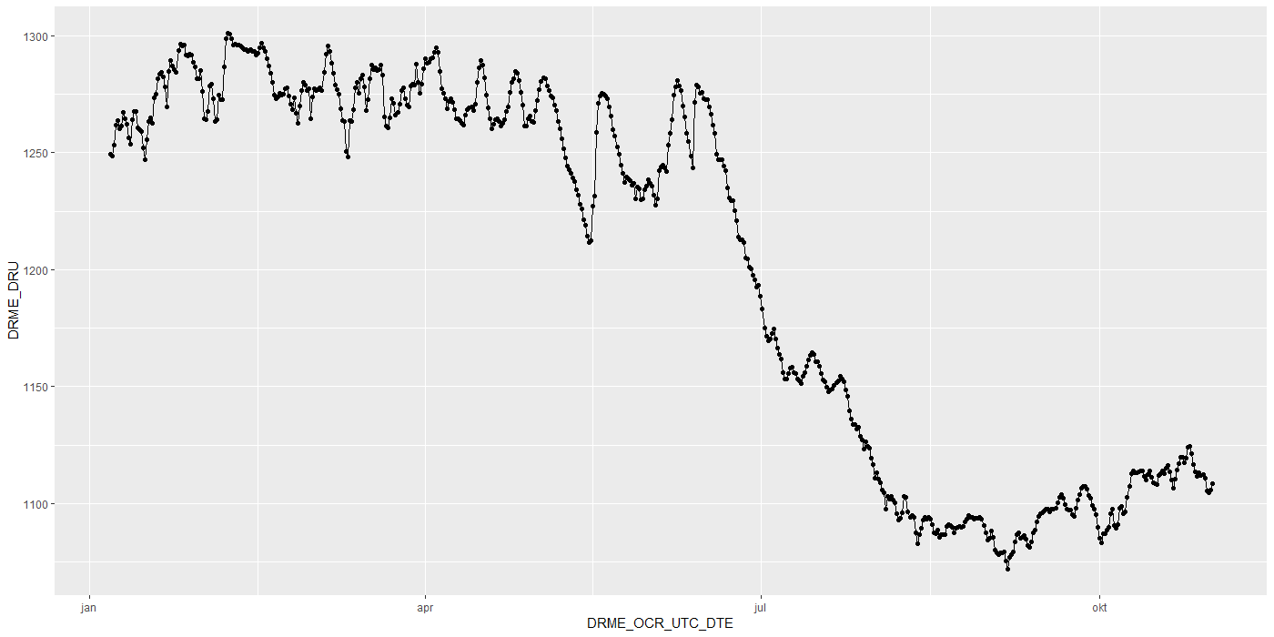
Level shift?

Slide 25
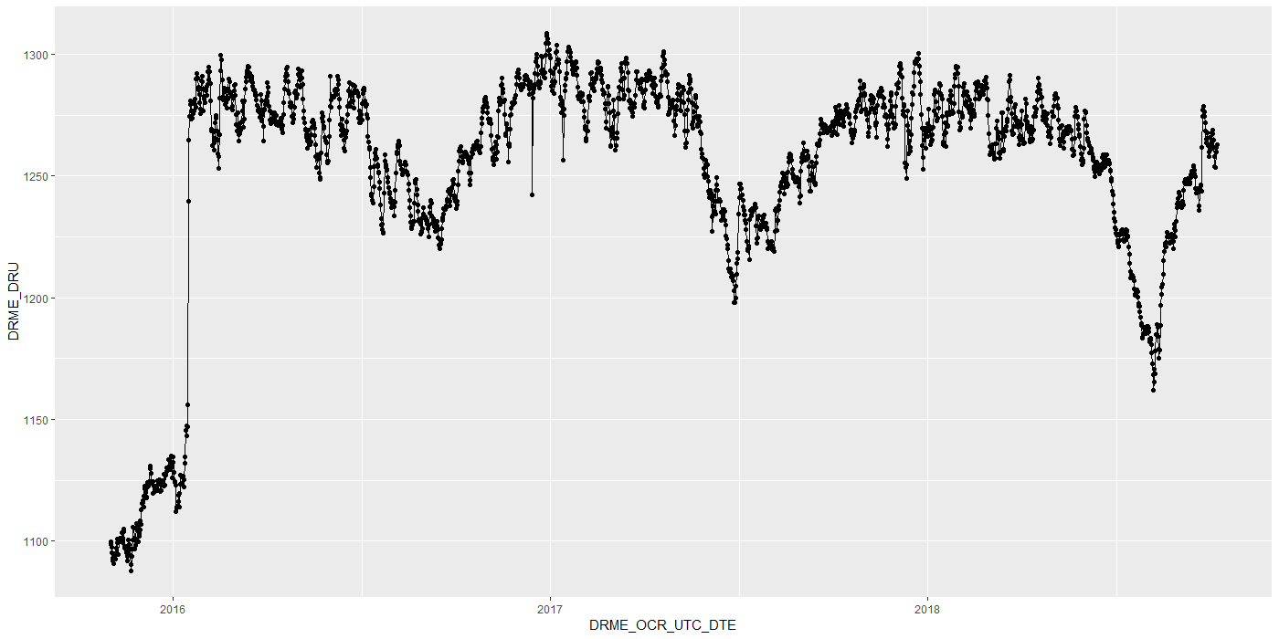
Level shift?

Slide 26
Level shift?

Slide 27
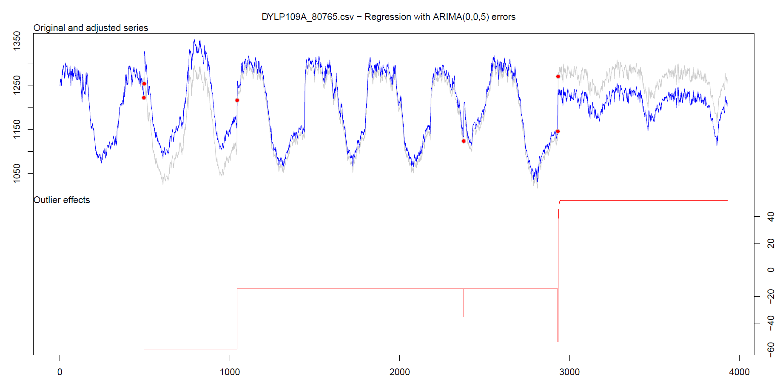
Level shift: tsoutliers

Slide 28
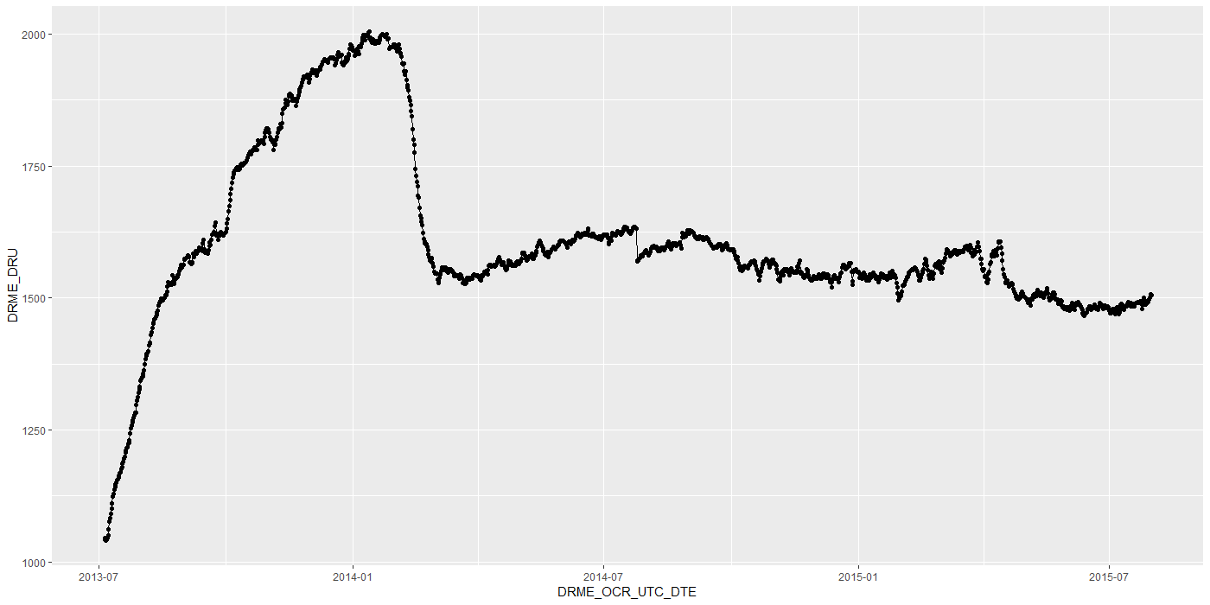
Level shift?
Notes:
Is rood een flat line?

Slide 29
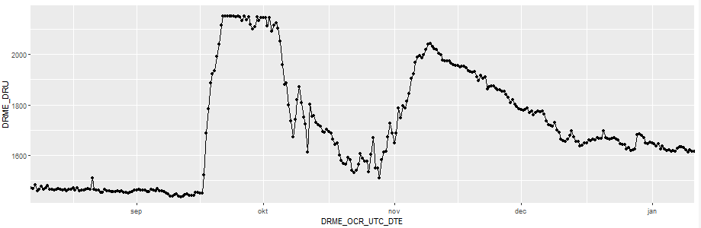
Level shift?
?
Notes:
Is rood een flat line?

Slide 30
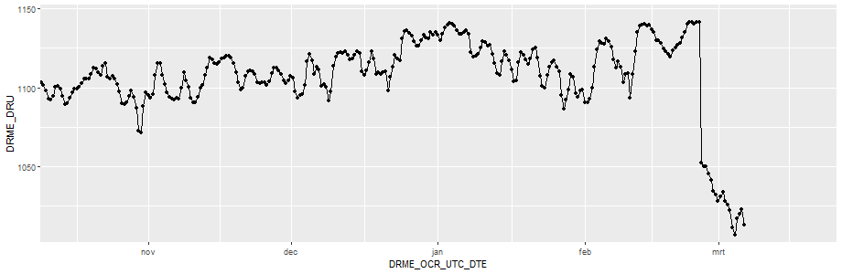
Level shift?
Notes:
Is rood een flat line?

Slide 31
Timestamps

Slide 32
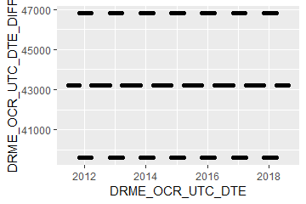
Timestamps: varying time-difference between observations (BAOL068X_180816.csv)
Sometimes 11, 12 or 13 hours
Notes:
BAOL068X_180816.csv

Slide 33
Timestamps: varying time-difference between observations
Equidistant observations are important for ARIMA-like timeseries models.
Without equidistance, the usability of ARIMA is limited.
Example: Differencing
For small time-differences: measured differences determined by sensor inaccuracy
For large time-differences: measured differences determined by sensor inaccuracy and atmospheric changes.
Timestamps: Take into account all kinds of scenarios?

Slide 34
Importance
Visualization:
Its either TIMESTAMP or SEQUENCE
INBO:
Can make sure that timestamp is always available.
Other parties?

Slide 35
gwloggeR
Change log
Feedback?

Slide 36
Change log
“Diver” → “hydrostatic pressure”
ap <- apriori("hydrostatic pressure", "cmH2O")
detect_outliers(x, apriori = ap)
detect_duplicates(ts)

Slide 37
Aggregation function
Lump together and take average.
Other (better?) ways?

Slide 38
Next steps

Slide 39
Next steps
Outliers v0.02
Build kernel based on clean data
Simulation test: verify power
Document in detail
Level shifts:
Gather more Level Shift examples
Better visusalisation
“Nederlanders”?
Notes:
temporal change : multiple points after the change should be “red”
Level shifts: how to flag those?

Slide 40
Hysteresis?

Slide 41
The End

Slide 42
Sprint 2
Outliers

Slide 43
Agenda
DRME_DMST_CDE validation
Outliers: v0.02 update
Comparison v0.01 vs v0.02
gwloggeR v0.1.1
Assessment
anomalize
tsoutliers

Slide 44
DRME_DMST_CDE
Flags from DB: ENT (entered); DEL (deleted) and INV (invalid).

Slide 45
DRME_DMST_CDE
On all *.csv-data:
DEL ENT INV VLD <NA>
462 556271 4697 16 0

Slide 46
DRME_DMST_CDE: VLD and DEL
PPNT_ID PPNT_CDE DRSO_ID DRSO_SER_NBR DRME_ID DRME_OCR_UTC_DTE DRME_DRU DRME_TPU DRME_DMTP_CDE DRME_DMST_CDE SEQUENCE
1: 7019 BAOL001X 275 D0939 238389 2010-11-11 10:00:00 1018.100 NA LDME VLD 1093
2: 7019 BAOL001X 275 D0939 1824560 2010-11-11 10:00:00 1018.075 6.033 LDME ENT 1130
3: 7019 BAOL001X 275 D0939 238390 2010-11-11 22:00:00 1007.300 NA LDME VLD 1094
4: 7019 BAOL001X 275 D0939 1824561 2010-11-11 22:00:00 1007.275 8.163 LDME ENT 1131
5: 7019 BAOL001X 275 D0939 238391 2010-11-12 10:00:00 1015.400 NA LDME VLD 1095
6: 7019 BAOL001X 275 D0939 1824562 2010-11-12 10:00:00 1015.375 11.213 LDME ENT 1132
7: 7019 BAOL001X 275 D0939 238392 2010-11-12 22:00:00 1012.900 NA LDME VLD 1096
8: 7019 BAOL001X 275 D0939 1824563 2010-11-12 22:00:00 1012.850 12.457 LDME ENT 1133
9: 7019 BAOL001X 275 D0939 238393 2010-11-13 10:00:00 1014.600 NA LDME VLD 1097
10: 7019 BAOL001X 275 D0939 1824564 2010-11-13 10:00:00 1014.600 10.810 LDME ENT 1134
11: 7019 BAOL001X 275 D0939 238394 2010-11-13 22:00:00 1012.700 NA LDME VLD 1098
12: 7019 BAOL001X 275 D0939 1824565 2010-11-13 22:00:00 1012.675 10.953 LDME ENT 1135
Duplicates: Detect those too?
Notes:
Duplicaten in de DB?

Slide 47
DRME_DMST_CDE: INV
Validation

Slide 48
DRME_DMST_CDE: INV
Validation

Slide 49

DRME_DMST_CDE: INV
Validation
No Timestamp (Inconsistent)
No Timestamp: Detect those too?
Notes:
Inconsistent because there are also black dots that have no timestamp.

Slide 50
Outliers: v0.02 update
Uses simple a-priori knowledge about air pressure, temperature, etc.

Slide 51
Outliers: v0.02 update
Validation
Excluded: BAOL089|BAOL079|BAOL006 (mBar)
Range: 800 < x < 1200
Notes:
Excluded: BAOL089|BAOL079|BAOL006
Range: 800 < x < 1200

Slide 52
Outlier comparison
v0.01, v0.02, DRME_DMST_CDE

Slide 53
Outlier comparison

Slide 54
Outlier comparison

Slide 55
Outlier comparison

Slide 56
Outlier comparison

Slide 57
Outlier comparison

Slide 58
Outlier comparison

Slide 59
Outlier comparison

Slide 60
Outlier comparison

Slide 61
tsoutliers package

Slide 62

tsoutliers package
auto.arima(Nile)
Series: Nile
ARIMA(1,1,1)
Coefficients:
ar1 ma1
0.2544 -0.8741
s.e. 0.1194 0.0605
sigma^2 estimated as 19769: log likelihood=-630.63
AIC=1267.25 AICc=1267.51 BIC=1275.04
nile.outliers <- tso(Nile,types = c("AO","LS","TC"))
nile.outliers
Series: Nile
ARIMA(0,0,0) with non-zero mean
Coefficients:
intercept LS29 AO43
1097.7500 -242.2289 -399.5211
s.e. 22.6783 26.7793 120.8446
sigma^2 estimated as 14401: log likelihood=-620.65
AIC=1249.29 AICc=1249.71 BIC=1259.71
Outliers:
type ind time coefhat tstat
1 LS 29 1899 -242.2 -9.045
2 AO 43 1913 -399.5 -3.306
Notes:
https://stats.stackexchange.com/questions/104882/detecting-outliers-in-time-series-ls-ao-tc-using-tsoutliers-package-in-r-how

Slide 63
tsoutliers package: AO’s

Slide 64
tsoutliers package: AO’s

Slide 65
tsoutliers package: AO’s
WRONG
TIMESTAMPS NOT SEQUENTIAL
Notes:
Afstandedn veel groter sinds 2018

Slide 66

tsoutliers package
Pros:
Formalism
Integration with (S)ARIMA
Cons:
Speed? (+12h on BAOL033X_C6550.csv)
Ad-hoc (messy) solution
ToDo:
Simulations for validation
Visualization of AO, LS en TC outliers
Think it best works with “all” outliers enabled.
Notes:
Zou best

Slide 67
anomalize package

Slide 68

anomalize package
vs. tsoutliers
Notes:
Same Nile dataset

Slide 69
anomalize package
Pros:
Straightforward and fast timeseries decomposition
Cons:
Only AO
LS and TC can not be specified
Not backed by decent theory
Notes:
Zou best

Slide 70
gwloggeR
Feedback?

Slide 71
Next steps

Slide 72
Next steps
Define control vocabulary?
Suggested function output:
?
Notes:
temporal change : multiple points after the change should be “red”
Level shifts: how to flag those?

Slide 73
Next steps
Go further with tsoutliers
Visualisation: level shift (LS)
Simulations
Give a better idea of model performance for specific cases
Examples:
ARIMA(0,0,0) with AO
ARIMA(0,0,0) with LS
etc.
gwloggeR versioning?
Notes:
temporal change : multiple points after the change should be “red”
Level shifts: how to flag those?

Slide 74
The End

Slide 75
Sprint 1
Outliers

Slide 76
Outliers
v0.01: detect_outliers(data)
Uses only the supplied dataset
v0.02: detect_outliers(data, type = c(“air pressure”, “air temperature”), units)
Uses simple a-priori knowledge about air pressure, temperature, etc.
v0.03: …

Slide 77
Outliers: v0.01
Uses only the supplied dataset

Slide 78
Outliers: v0.01
Validation

Slide 79
Outliers: v0.01
Validation

Slide 80
Outliers: v0.01
Validation

Slide 81
Outliers: v0.01
Validation

Slide 82
Outliers: v0.01
Validation

Slide 83
Outliers: v0.01
Validation

Slide 84
Outliers: v0.01
Validation

Slide 85
Outliers: v0.01
Validation
Scale completely wrong?

Slide 86
Outliers: v0.02
Uses simple a-priori knowledge about air pressure, temperature, etc.

Slide 87


Outliers: v0.02
Validation

Slide 88
Outliers: v0.02
Validation

Slide 89
Outliers: v0.02
Validation

Slide 90
Outliers: v0.02
Validation

Slide 91
Summary
Outliers: v0.01
detect_outliers(data)
Usable on any data (not only L - lucht)
Scale can be completely wrong (cf. BAOL018X_42112)
Outliers: v0.02:
detect_outliers(data, type = c(“air pressure”, “air temperature”), units)
Needs a-priori information
Type
Units
Fixed or dynamic thresholds?
Notes:
Tresholds voor outliers kunnen berekend worden op basis van handmatige prior analyse, of

Slide 92
Outliers: v0.03
Go even further with a-priori information?

Slide 93

Outliers: v0.03
Even more a-priori information to explain variation
Notes:
Bijvoorbeeld, somige regio’s hebben lagere of hogere temperature, wat resulteert in hogere of lagere luchtdruk.

Slide 94
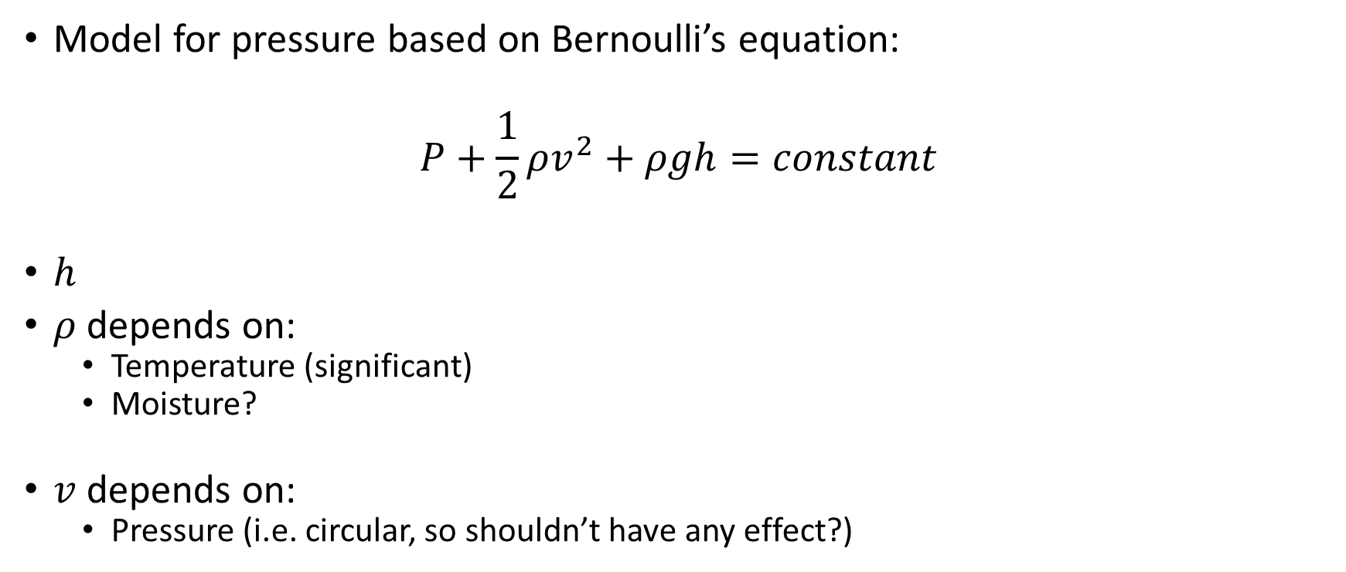
Outliers: v0.03
Model for pressure based on Bernoulli’s equation:
$$P+\frac{1}{2}ρv^{2}+ρgh=constant$$
$h$
$ρ$ depends on:
Temperature (significant)
Moisture?
$v$ depends on:
Pressure (i.e. circular, so shouldn’t have any effect?)

Slide 95

Outliers: v???
First order difference: very long tails
Notes:
Very long tails, not normal

Slide 96
Next steps

Slide 97
Next steps
Make first version of package with outlier detector 0.01 and 0.02?
If no extra data supplied, use v0.01, else v0.02?
v0.02: fixed or dynamic thresholds?
Other ideas?
Notes:
Misschien best om zo snel mogelijk met package te beginnen: dan kan gebruik meteen geevalueerd worden.

Slide 98
The End

